Slide 1
THE INDUSTRIAL REORGANIZATION OF THE CORE
Impacts in the Core Economies of Globalization of Production
Lecture 13: Nature and Location of Jobs
Lecture 14: Changing Economic Logic/Regional Motors

Slide 2
Lecture 13: A. The changing nature and location of jobs, 1970s-present
Nature of jobs:
1. Increased capital intensity in manufacturing and labor-intensive jobs off-shored. New technologies as important in reducing manufacturing jobs as globalization (Figure 1, Figure 16, Figure 18). Jobs of “the future” will be the ones least affected by automation (Figure 17).
2. Rise of dual structure service sector based on educational polarization: producer and financial (FIRE) versus consumer services (retail, healthcare (not medics), personal services, etc.) (Figure 2). Some service sector jobs in business services subject to outsourcing via offshoring (Figure 3). Similarly in manufacturing, the process is very specific to different industries (Figure 4). Manufacturing jobs that used to require a high school education or less have been disappearing (Figure 5).

Slide 3
3. Increased income and wealth inequality since the 1970s (Figures 6-11) . Capital benefits much more than labor from globalization (Figure 9). Decline of unions. Decreased high marginal income tax rates. Rising CEO pay relative to workers (Figure 12). Declining social mobility (particularly in the US)? (Figure 20).
4. Decrease in employment (rising dependent population) (Figure 14) Increase in part-time employment and structural unemployment (Figure 15). Old assumption that there is a correlation between unemployment and inflation (change in consumer prices) no longer seems to hold because a. labor markets are longer national and b. inflation is no longer driven by wage increases/decreases of the employed as in the 1950s and 1960s (Figure 19)
5. Rise of financial services industry as driver of economic growth in large cities in the core countries (particularly in US and UK) (Figures 21 and 22).

Slide 4
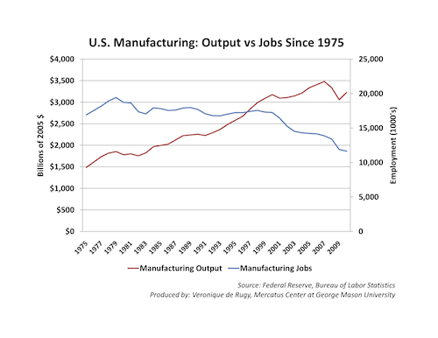
Figure 1

Slide 5
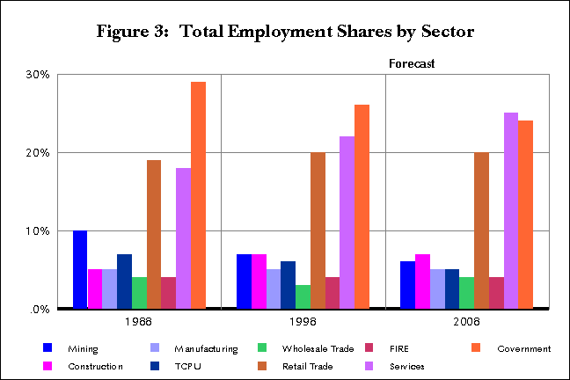
Figure 2: US Structure of Employment (Decline of manufacturing jobs)

Slide 6
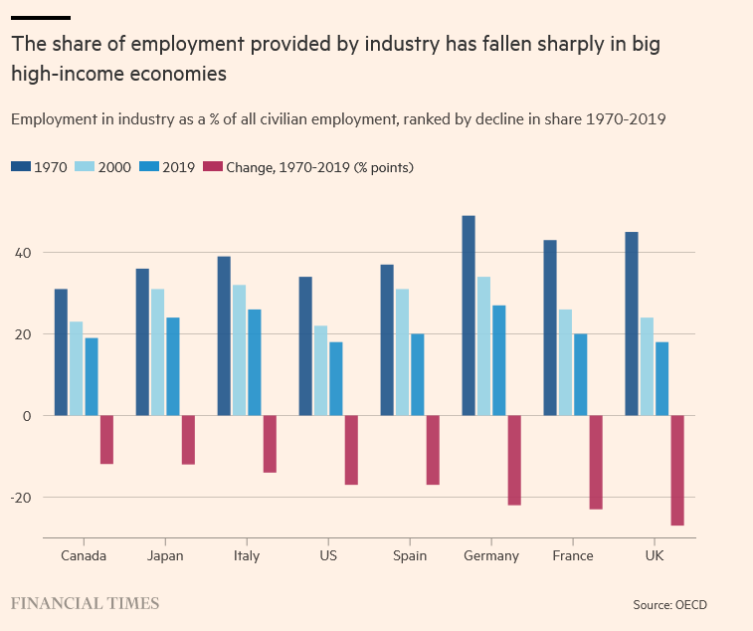
Figure 2a: Not Just the USA

Slide 7
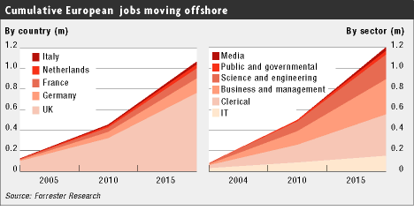
Figure 3: Service Jobs Redistributed Worldwide

Slide 8
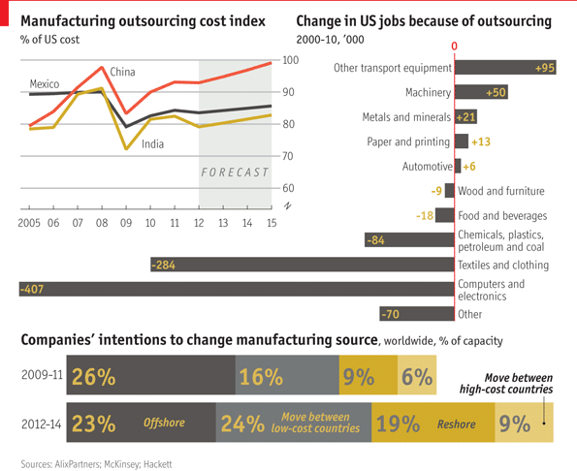
Figure 4: Outsourcing abroad = offshoring

Slide 9
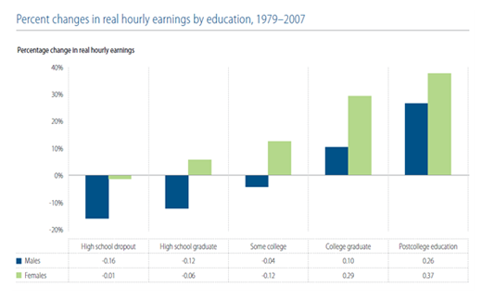
Figure 5: Stay in School!

Slide 10
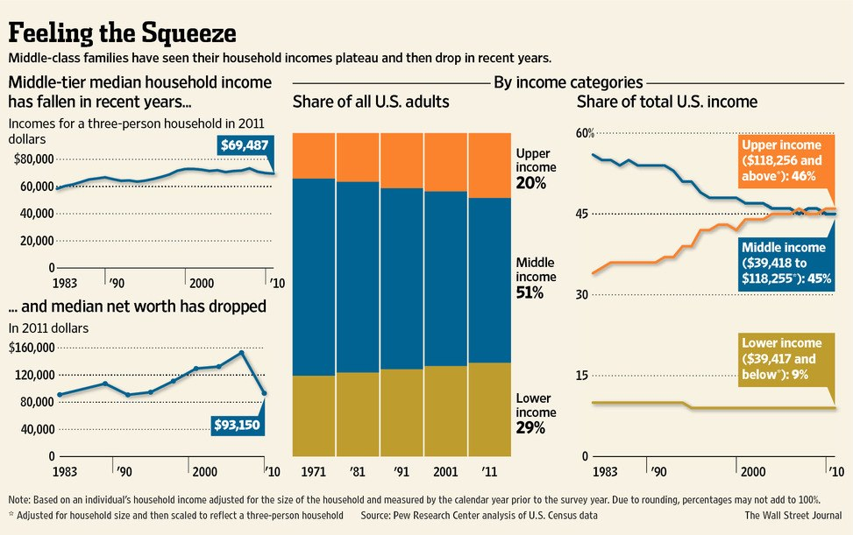
Figure 6: Increasing Income Inequality in the US

Slide 11
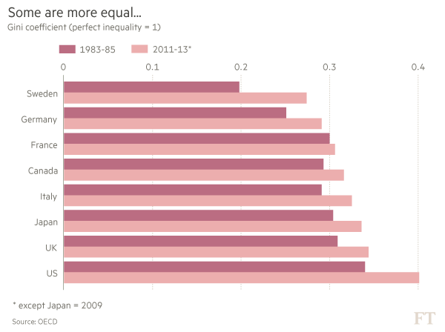
Figure 7: Gini Coefficients for 8 Core Countries (Sweden much more equal than the US)

Slide 12
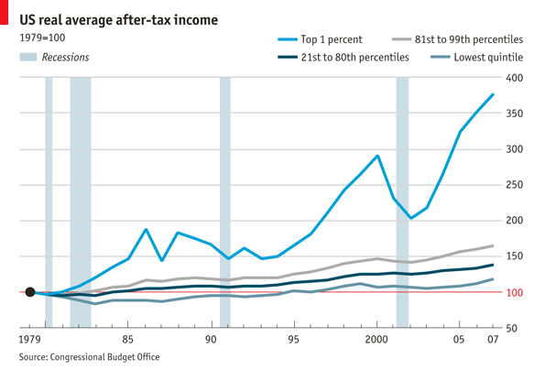
Figure 8: Another way of looking at increased income inequality by social class in the US

Slide 13
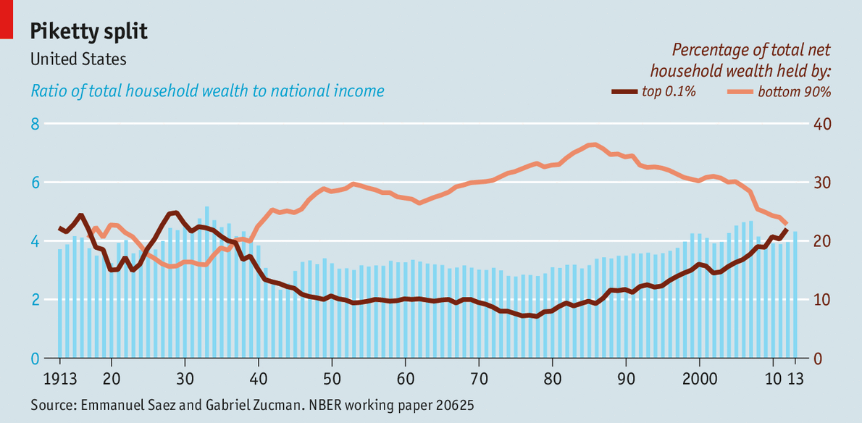
Figure 9: Wealth (assets not just income also increasingly unequal in its distribution) 1913-2013

Slide 14
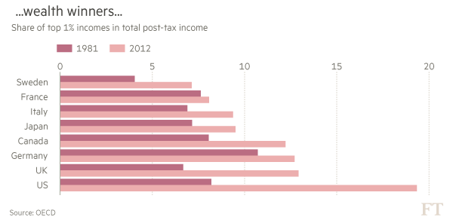
Figure 10: The US compared to other core countries in terms of wealth inequality between 1981 and 2012

Slide 15
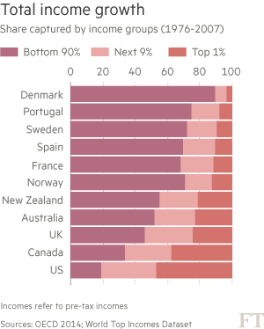
Figure 11: Income Growth Captured by Different Percentiles

Slide 16
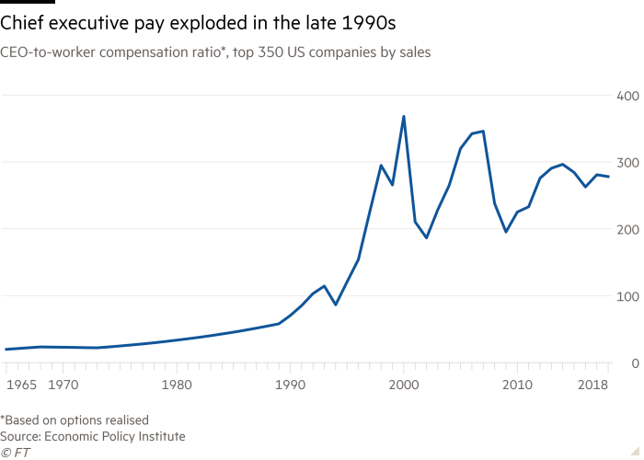
Figure 12: The explosion of the CEO versus worker wage gap in the US (1965-2019)

Slide 17
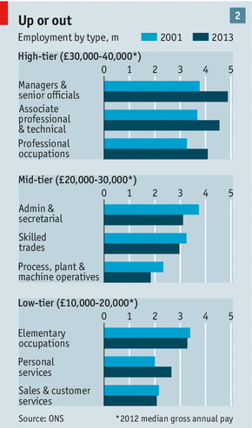
Figure 13: The Shrinking Middle in numbers employed in the UK (2001-2013)

Slide 18
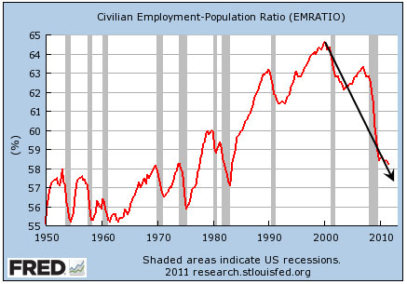
Figure 14: Shrinking numbers of employed relative to population in the US

Slide 19
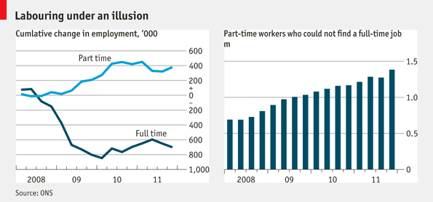
Figure 15: The growth of unstable and part-time employment in the US

Slide 20
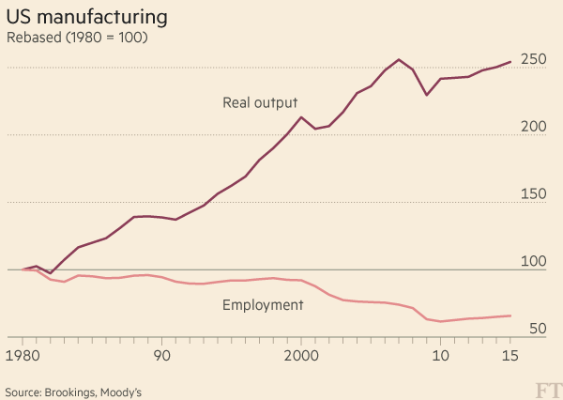
Figure 16: Machines substitute for labor as the US produces more but with fewer workers

Slide 21
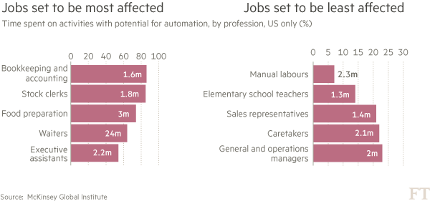
Figure 17: The Future of Occupations in the US

Slide 22
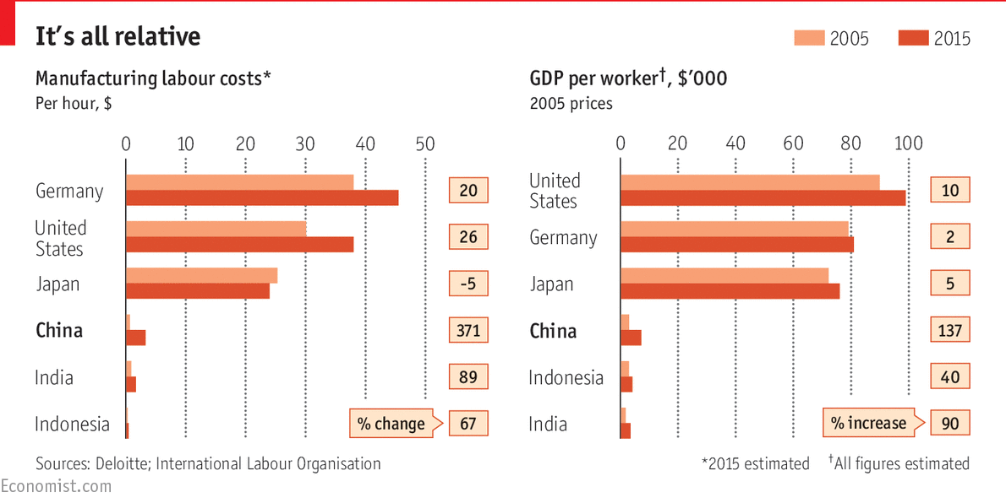
Figure 18: Labor and changing competitive advantage. Workers in historic core countries still much more productive but also MUCH more expensive.

Slide 23
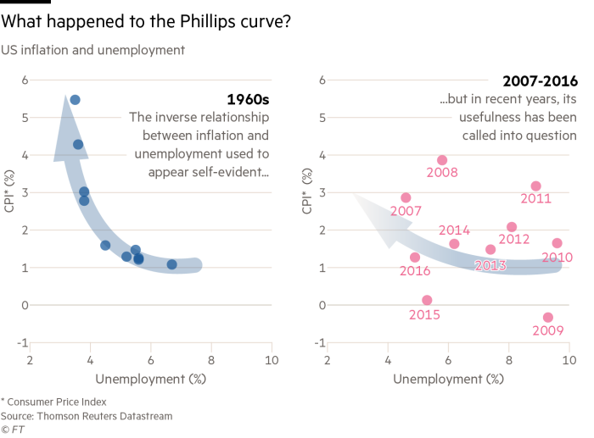
Figure 19: The relationship between unemployment rate and inflation rate has broken down.

Slide 24
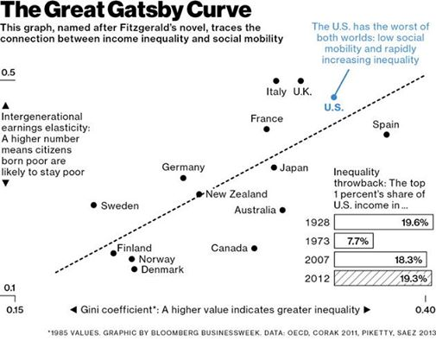
Figure 20: Social mobility and income inequality

Slide 25
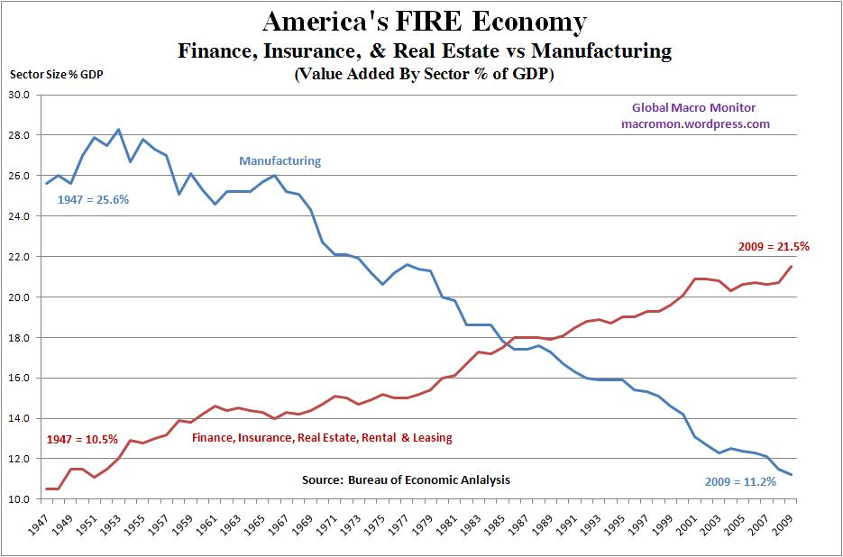
Figure 21: Finance in the US

Slide 26
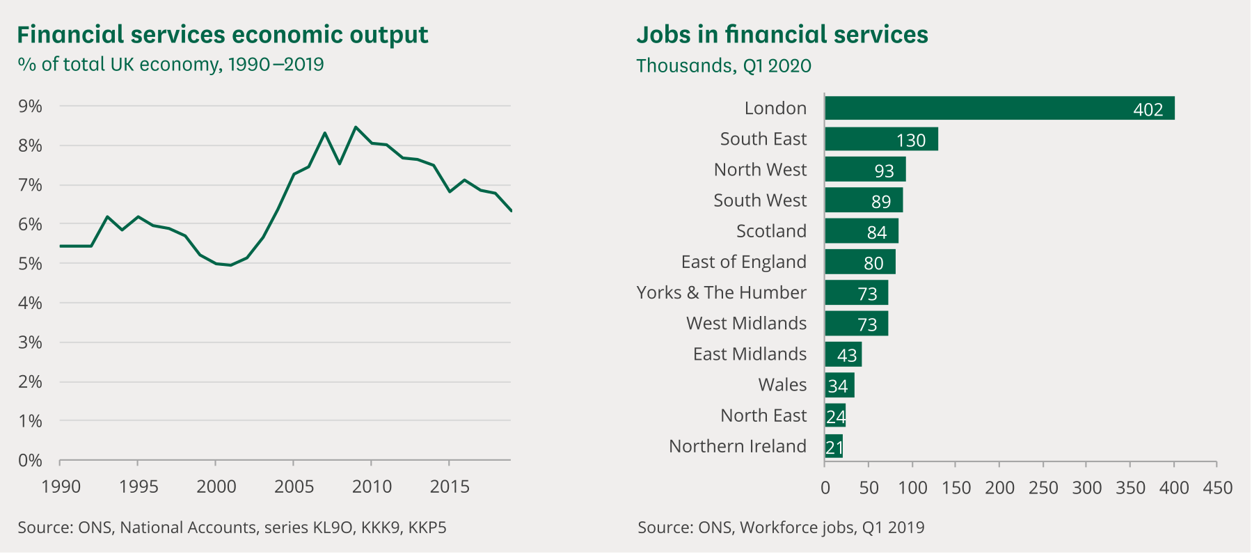
Figure 22: Finance in the UK

Slide 27


Slide 28
Lecture 14: B. Changing Economic Logic for Locating Production
(1) Location of jobs:
Where are core economies growing in jobs and incomes? (Figures 1 and 2).
Some big cities (Figure 3; also Figures 1&2)
Some specialized industrial districts (Figure 4)
(2) Explaining this: decreased transport costs; vertical disintegration of large firms (out-sourcing increasingly via offshoring); agglomeration economies

Slide 29
What are agglomeration economies:
1. local suppliers/specialized services; 2. local specialized labor pools; 3. local learning effects; 4. trust and collaboration from face-to-face interaction.
(3) Putting all of this together in the Regional Motors Model (Figures 5&6).

Slide 30
In Sum:
Three trends at work in redistributing growth and jobs:
Decreased transport costs as part of production costs;
Vertical disintegration of large firms (out-sourcing);
Increased role of agglomeration (localization and urbanization) economies in core economies.

Slide 31
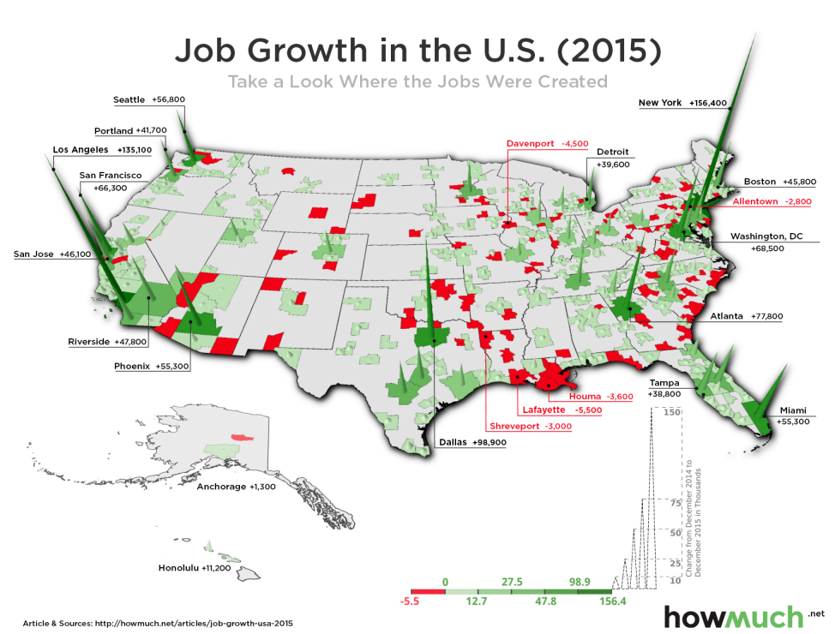
Figure 1: US Job Growth

Slide 32
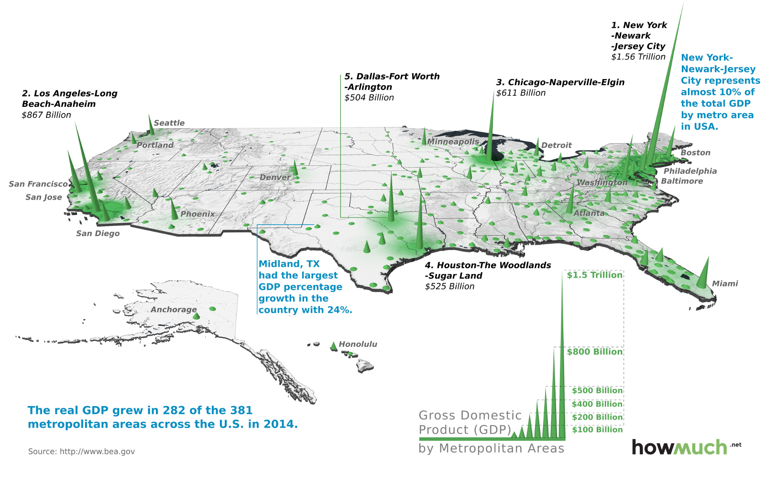
Figure 2: US GDP Growth

Slide 33
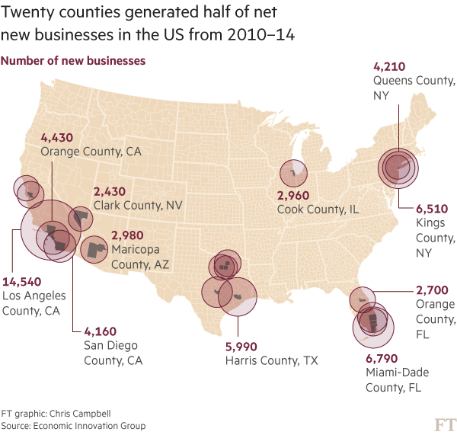
Figure 3: New Business Starts in the US 2010-2014

Slide 34
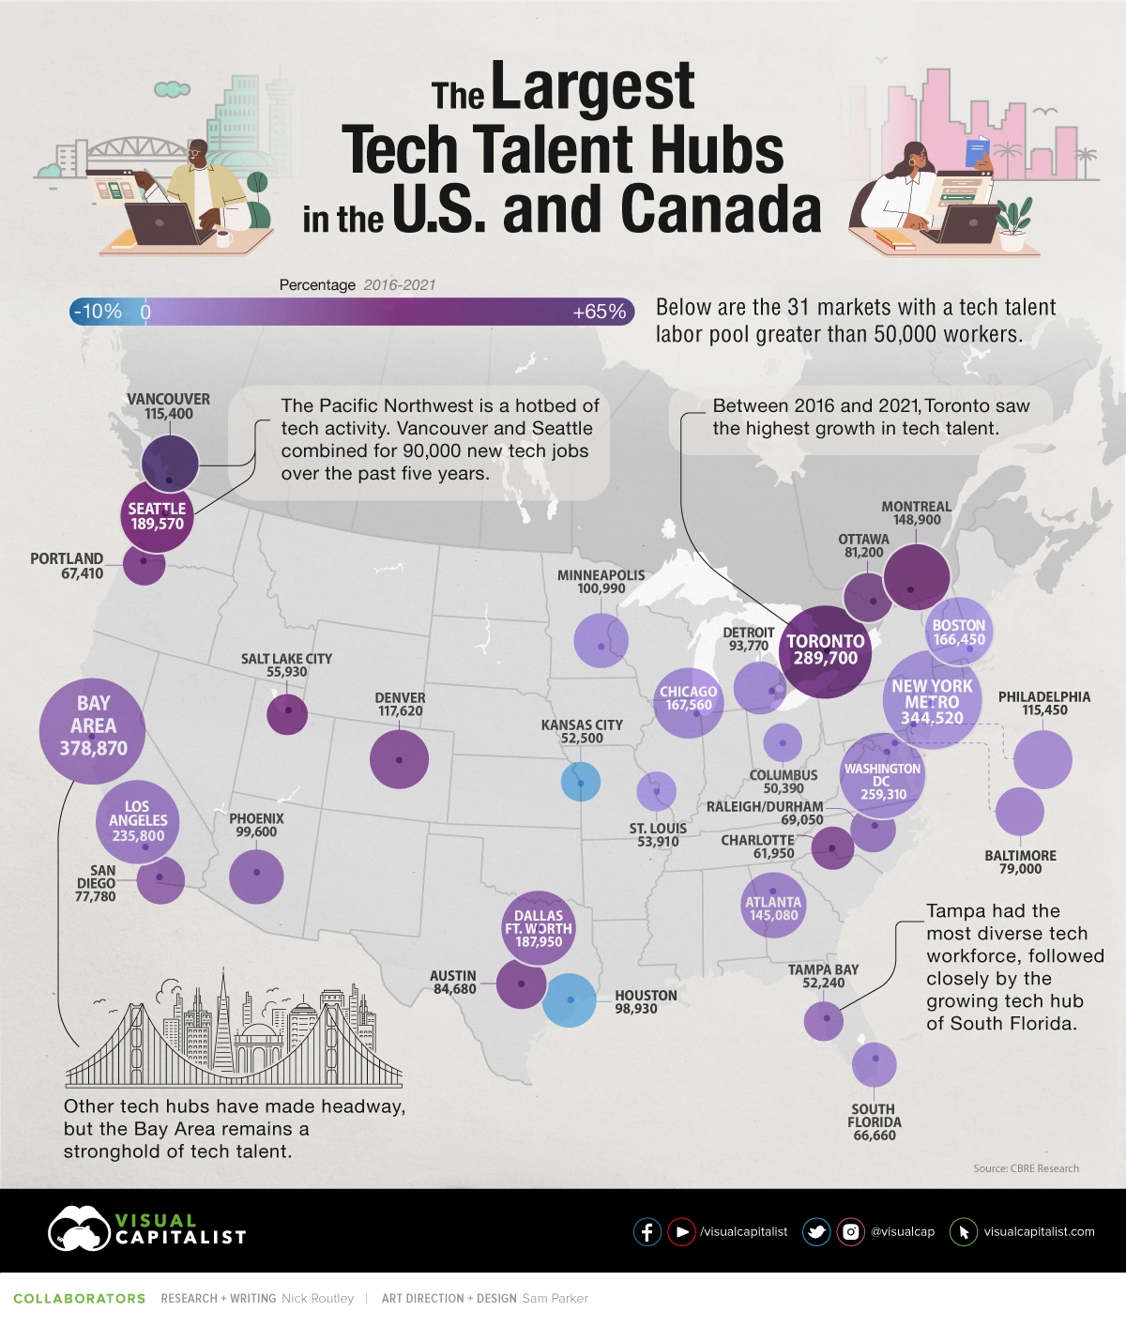
Figure 3A: Tech Talent Hubs

Slide 35
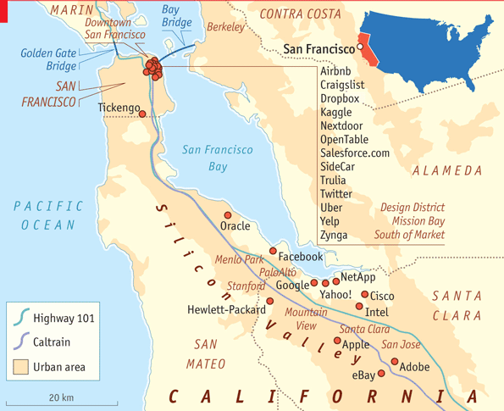
Figure 4: The Bay Area and Silicon valley

Slide 36
Figure 5: The Regional Motors Model
The matrix of transport/communication costs versus agglomeration economies
Six scenarios:
Transport/Communication Costs
Agglomeration Low Medium High
Economies
Low 4 5 1
High 3 6 2

Slide 37
Scenarios 6 and 2 have become more important in the core than 5, 1, and 3.
1 is like the early Industrial Revolution
3 is branch-plant industrialization (as in globalization of production); external economies still within firms NOT places.
4 is spatial entropy (e.g. telecommuting)
6 = large metropolitan areas with super-agglomeration economies (particularly FIRE sector) – New York/London; 2 = industrial districts specialized in certain industries (e.g. Silicon Valley)

Slide 38
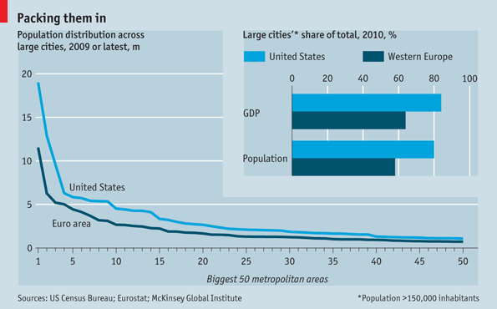
Figure 6: Large Cities have Driven GDP Growth

Slide 39
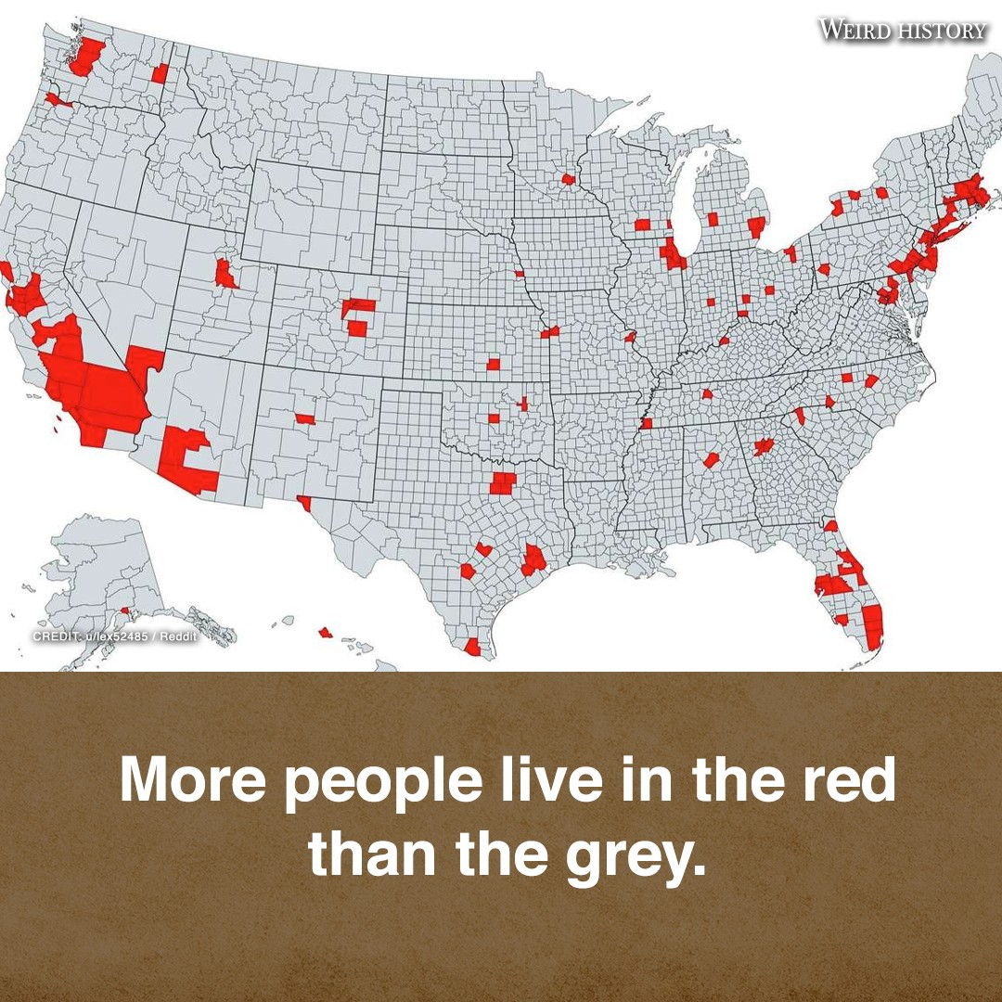
Figure 7: Just a Population Divide?

Slide 40
CONCLUSIONS
Not just changing types of jobs and locations of jobs in the core countries but also a changing economic logic to what and where they are.
Decline in number of manufacturing jobs and as share of employment even as manufacturing production does not decline (technology)
Rise of divided and polarized occupational distribution and income/wealth inequality
Rising importance of agglomeration economies in new sectors
Question of the day: Will increased remote working undermine agglomeration economies?

